Slide 1
AYAN DEEP HAZRA NLP GROUP 02/09/2021

Slide 2
Papers Explored
The Materials Data Facility: Data Services to Advance Materials Science Research
B. BLAISZIK , K. CHARD , J. PRUYNE, R. ANANTHAKRISHNAN, S. TUECKE , and I. FOSTER
doi: https://link.springer.com/article/10.1007/s11837-016-2001-3
Machine learning in materials informatics: recent applications and prospects
RAMPI RAMPRASAD, ROHIT BATRA , GHANSHYAM PILANIA, ARUN MANNODI-KANAKKITHODI AND CHIHO KIM
doi: https://www.nature.com/articles/s41524-017-0056-5

Slide 3
What I learnt
Machine Learning principles specific to MS&E
ML Process/Steps for predicting properties
Standard Algos/Deep Learning methods
Overview of One project that seeks to make chemistry literature more accessible to researchers/patent lawyers

Slide 4
1) Machine learning in materials informatics: recent applications and prospects
Summary: The article overviews some of the recent data-driven Material Science research strategies undertaken in the last decade and identifies challenges that the community is facing and those that should be overcome in the near future.
Given a data set of materials and a property, what is the estimate of said property for an element not in the dataset?
Step 1) Represent the input cases in the dataset/features/fingerprinting
Step 2) Mapping between the finger printed input and the target property.
Amount of data Standard Algorithms Kernel Ridge Regression
Deep Neural Networks Gaussian Process Regression
Still more problems: Too much or too less data, Overfitting of data

Slide 5
2) The Materials Data Facility: Data Services to Advance Materials Science Research
Summary: The group aims to build scalable, shared data services and provide common data infrastructure components and resources.

Slide 6
MDF overview
Data is arranged in terms of collections and datasets. A collection comprises a set of policies and a set of logically similar datasets.
MDF services attempt to address these key features at various levels through a flexible collection-oriented policy model.
MDF was built by adapting the commonly-used DSpace institutional repository system and augmenting its capabilities with enhanced search and large-scale data management functionality.

Slide 7
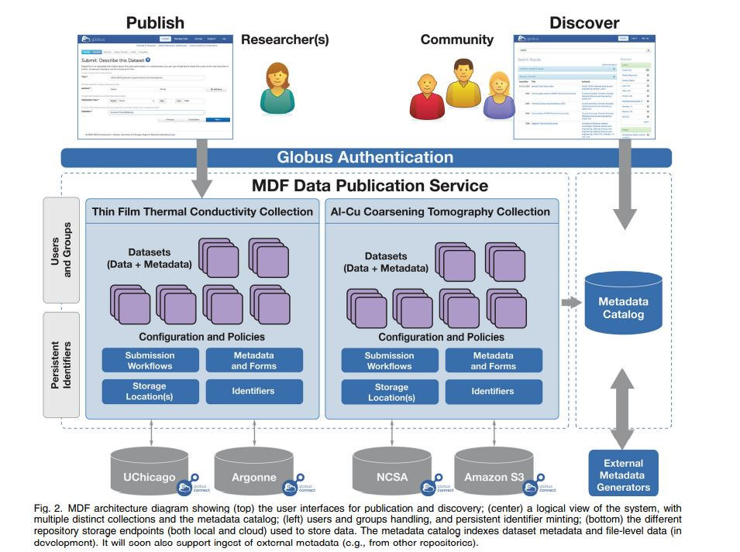
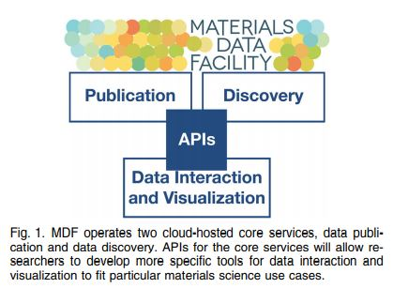
MDF Arch

Slide 8
Plus points of MDF
For scientific data to be broadly useful beyond its original purpose, it should be well described, discoverable, verifiable, and accessible:
Identification MDF data publications are uniquely identified with a collection-specific persistent identifier (PID).
Description MDF supports the description of published datasets by using arbitrary and extensible metadata.
Curation MDF supports the publication of data into user-managed collections. Depending on the context of these collections, there may be requirements (expressed or implicit) that data meet particular levels of completeness before being made available.
Access to data must be both intuitive and secure. MDF provides a Web user interface and will provide REST interfaces to access published data

Slide 9
Plus points of MDF (continued...)
Preservation requirements can vary by project, funding agency, and institution. MDF’s distributed data model allows collection owners to select a storage location most appropriate for their application.
Verifiability of data, especially with a distributed data model, is important so that users have an assurance that a specific dataset, once published, has not been changed.
Searchable Datasets are only useful to other researchers if they can find them. As the number and diversity of published datasets published with MDF increases, methods are needed to discover data of interest quickly and easily.
Browsable and Retrievable The MDF data publication service makes published data available via intuitive and standardized Web UI or REST interfaces. MDF supports standard Globus data access models that allow authorized users to download and transfer published datasets.

Slide 10
Next Steps for MDF
Based on user feedback, the group is enhancing MDF capabilities with increased metadata flexibility, customizable search, automated metadata extraction, and extensible APIs and python client libraries.
They are also investigating integration with the publication processes of academic publishers and a variety of institutions.
Collectively, these capabilities will further increase the value provided to materials scientists, while reducing overheads and enabling new integration scenarios.

Slide 11
Next Steps
Need to delve deeper to understand the architecture of MDF. Read more in-depth.

Slide 12
Summary of Work
Date | Hours Worked | Description
02/08/2021 | 2 | Read and made notes on the “Machine learning in materials informatics: recent applications and prospects” paper
02/09/2021 | 4 | Read and made notes on the “The Materials Data Facility: Data Services to Advance Materials Science Research” paper

